Slide 1


INFORMATION AND COMMUNICATION TECHNOLOGY– iGCSE - 2015-16
0417
Guide to Creating and editing Charts using Excel

Slide 2
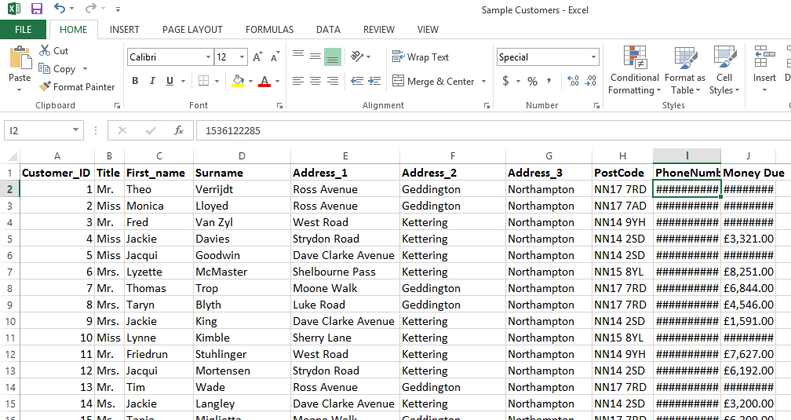
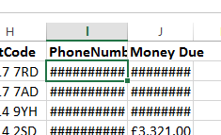
1 – Sorting the Customer Spreadsheet
In this section you will learn about:
How to Mail Merge an Excel File, Filter the contents of the file, create a letter appropriate for a circumstance.
Step 1 – First thing we need to do is examine the spreadsheet and be sure we know how to sort and filter the contents for our purposes. Open the spreadsheet called Sample Customers.
You will see that it is sorted by Customer_ID but there are hashes on the last columns. This means the column is not wide enough. Double click on the line between I and J to fix this and the same for the line between J and K.

Slide 3
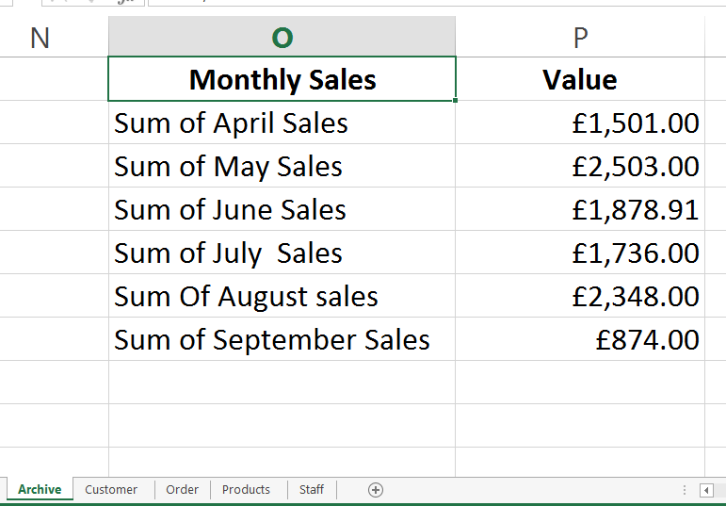
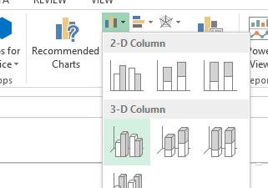
1 – Making a Bar Chart in Excel
Charts within excel will always come up in some form in the exam. These will either be Bar (Horizontal or vertical), Pie or Line, you will be asked to label them appropriately and possibly (Nov 2015) highlight one segment of the pie by removing it from the main. For this demonstration we will use the October Exam Table.
Step 1 – We will make a simple Bar chart using the information from the Archive Sheet of our spreadsheet.
Highlight all of the Monthly Sales and Value information including the figures.
Step 2 – Click on Insert and then Column Chart. This will depend slightly on the version of Excel you have.

Slide 4
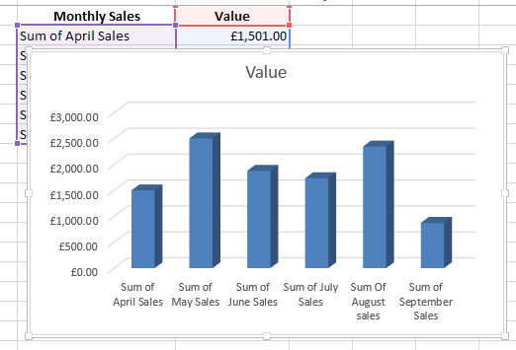
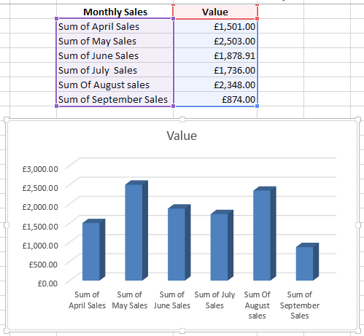
1 – Making a Bar Chart in Excel
Step 3 – A chart will appear but it will not be quite how you want it yet. Firstly we will need to move it off the Table by picking it up and moving it. If the table is too small to see all the titles on the bottom, then make it larger by dragging the corner of the outer box (not the corner of the chart). The chart will automatically update the information.
Step 4 -

